Slide 1

Tadpoles to frogs
By Noah Proctor

Slide 2
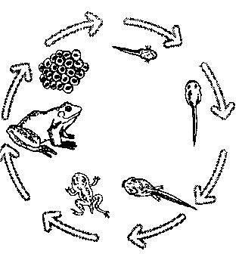
This the life cycle of a frog

Slide 3
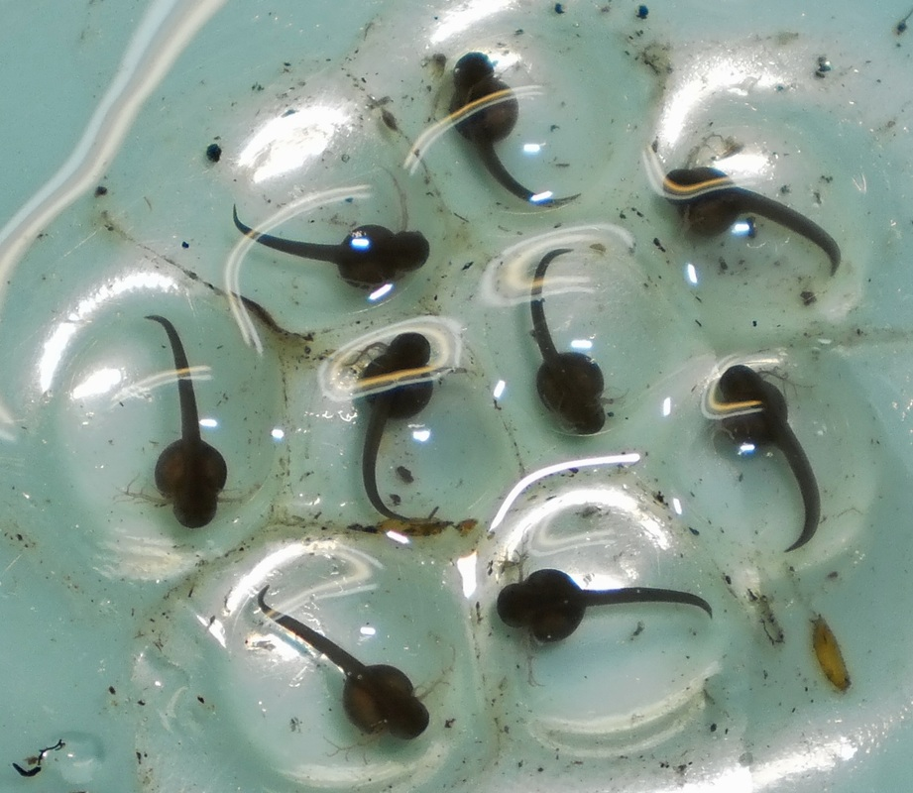
It all starts off very small
Notes:
poison dart frog tadpole

Slide 4
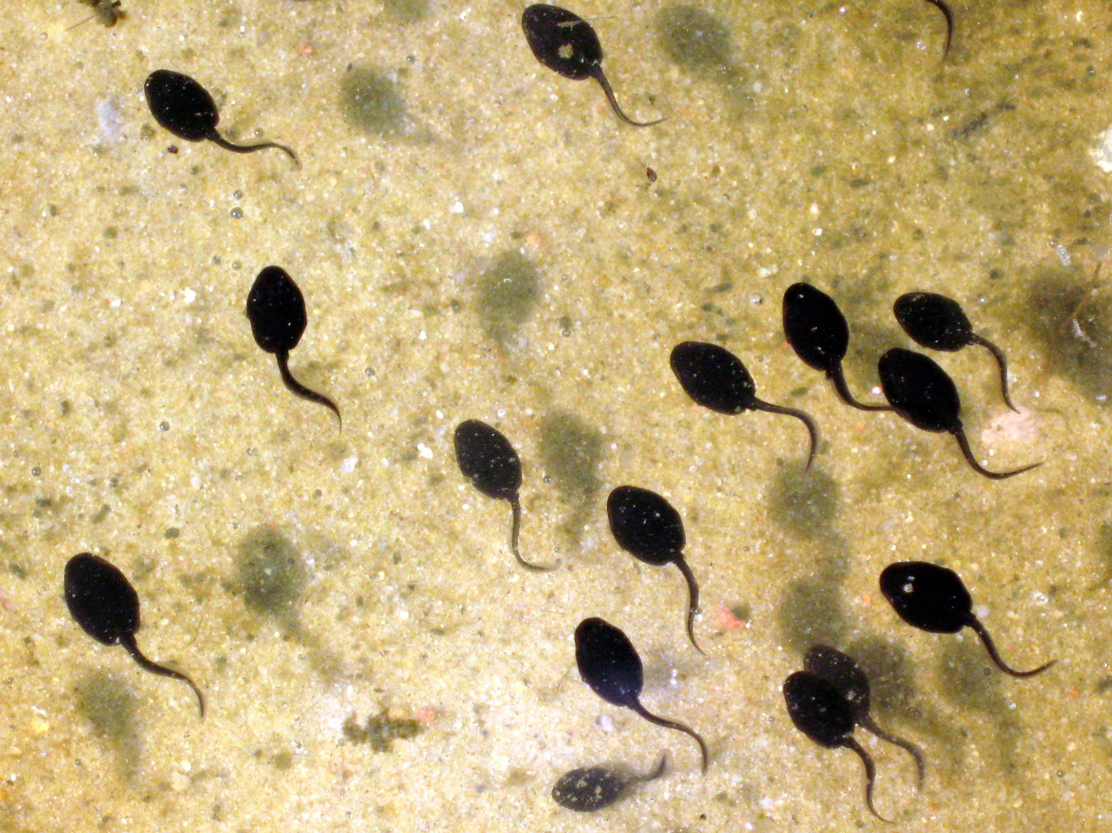
Next the eggs hatch into tadpoles

Slide 5
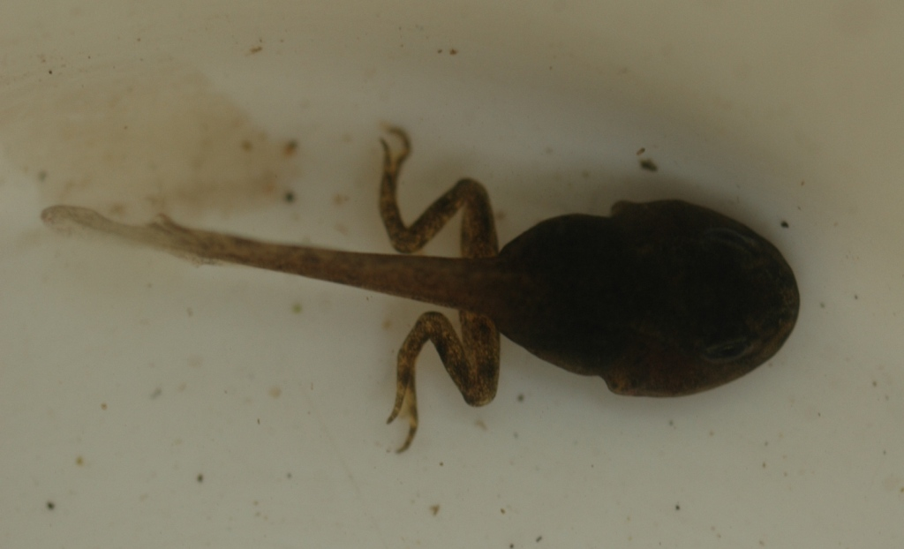
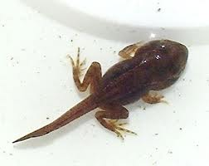
Then it grows its back legs

Slide 6
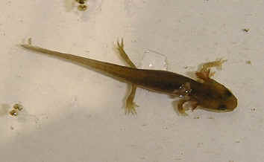
Next it grows its front legs

Slide 7
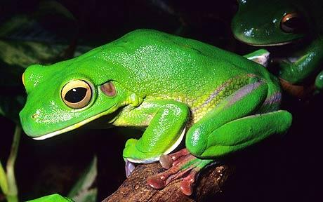
Soon it turns into a frog
`

Slide 8
I hop you enjoyed learning about tadpoles

